Slide 1
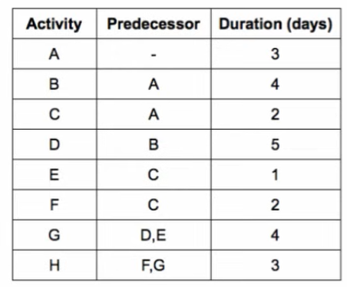
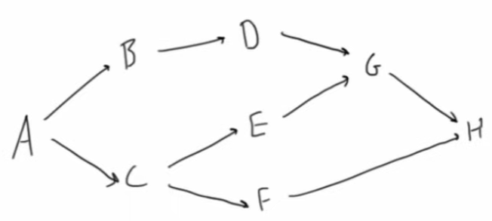
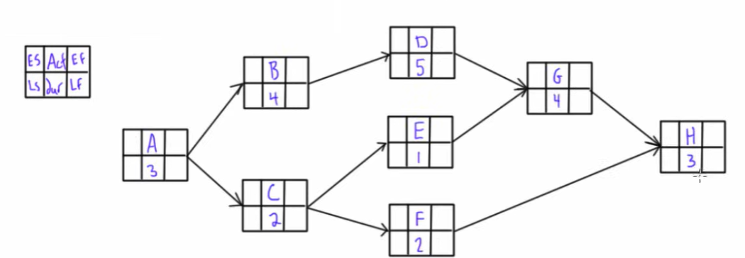
Forward and backward pass
Network diagram
ES: Early Start
EF: Early finish
Ls: Late start
LF: Late finish
Act. Activity
Dur. Duration
https://www.youtube.com/watch?v=4oDLMs11Exs

Slide 2
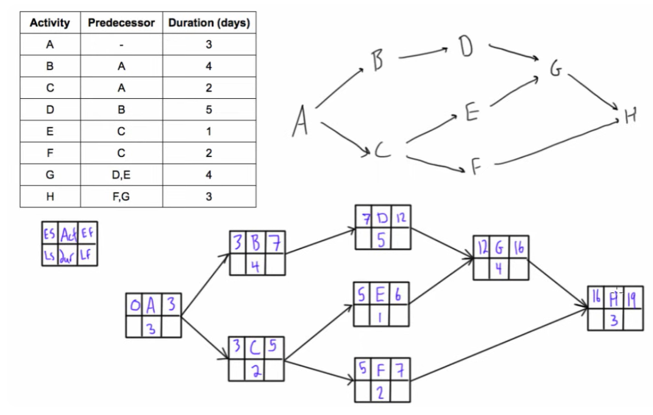
ES: Early Start
EF: Early Finish
Ls: Late start
LF: Late finish
Act. Activity
Dur. Duration

Slide 3
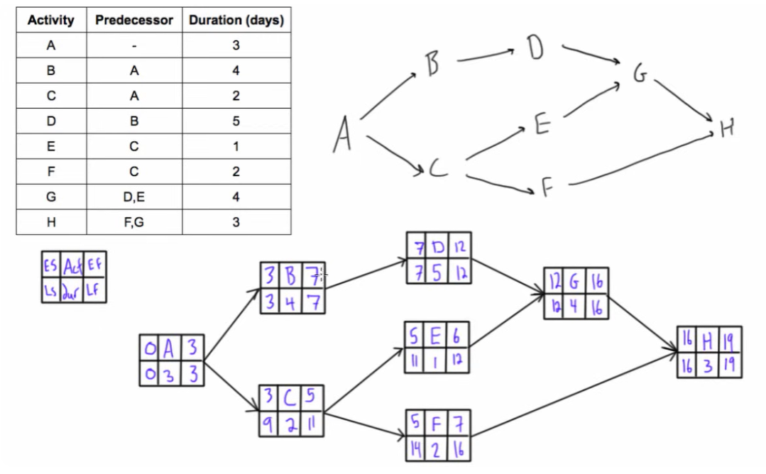

Slide 4
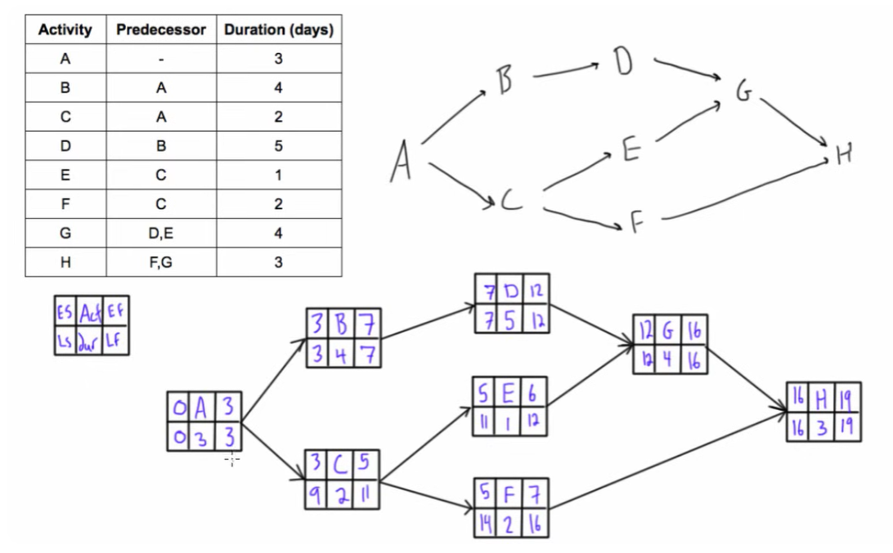
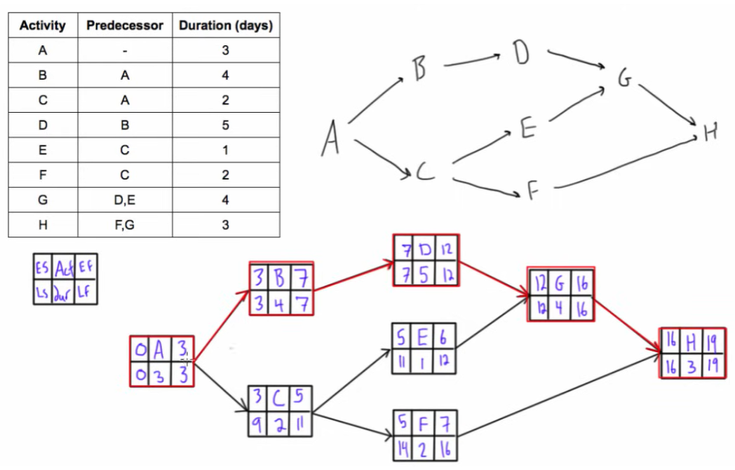
ES: Early Start
EF: Early finsh
Ls: Late start
LF: Late finish
Act. Activity
Dur. Duration

Slide 5
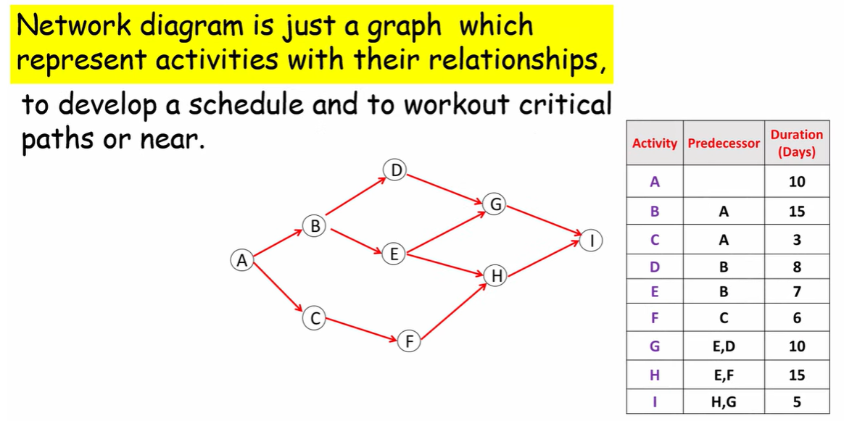

Slide 6
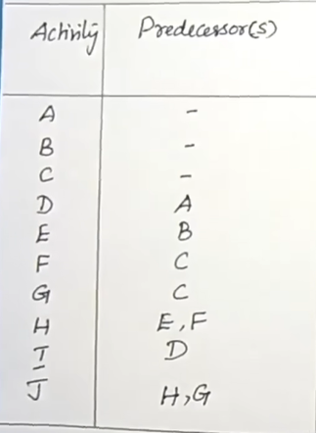
Program Evaluation and Review Technique -PERT

Slide 7
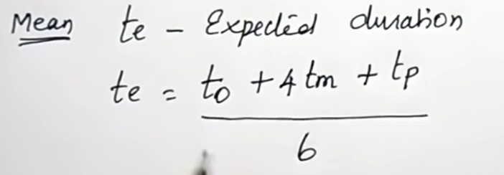
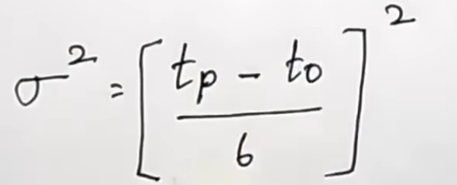
Activity | Predecessor | Duration weeks |  |  | Mean | Variance
 |  | Optimistic | Most likely | Pessimistic | Expected duration
A | - | 5 | 6 | 7 | 6 | 0.111111111
B | - | 1 | 3 | 5 | 3 | 0.444444444
C | - | 1 | 4 | 7 | 4 | 1
D | A | 1 | 2 | 3 | 2 | 0.111111111
E | B | 1 | 2 | 9 | 3 | 1.777777778
F | C | 1 | 5 | 9 | 5 | 1.777777778
G | C | 2 | 2 | 8 | 3 | 1
H | E,F | 4 | 4 | 10 | 5 | 1
I | D | 2 | 5 | 8 | 5 | 1
J | H,G | 2 | 2 | 8 | 3 | 1
Variance

Slide 8
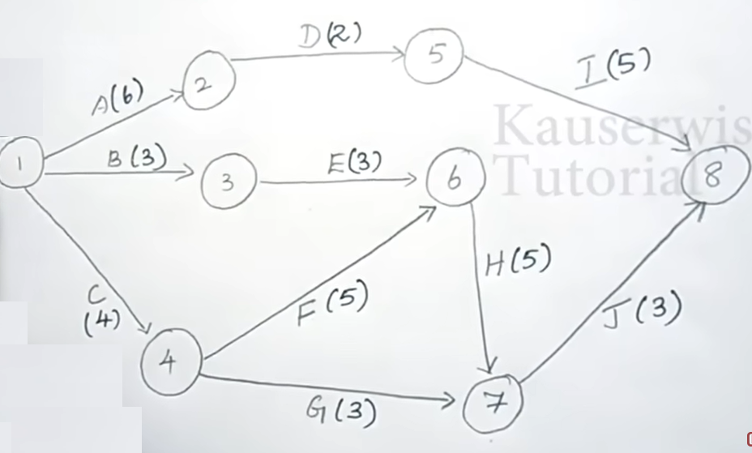

Slide 9
